Slide 1
Winter Winning Camp
DATABASE MANAGEMENT SYSTEM
Department Of Career Planning & Development

Slide 2
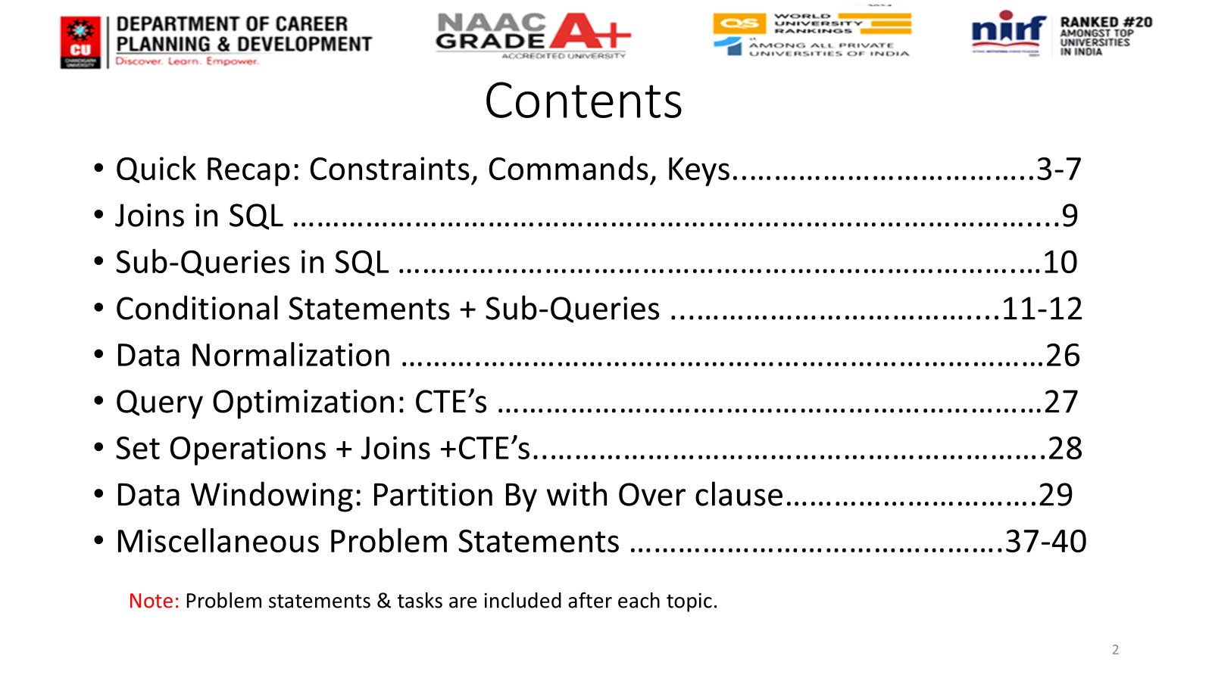
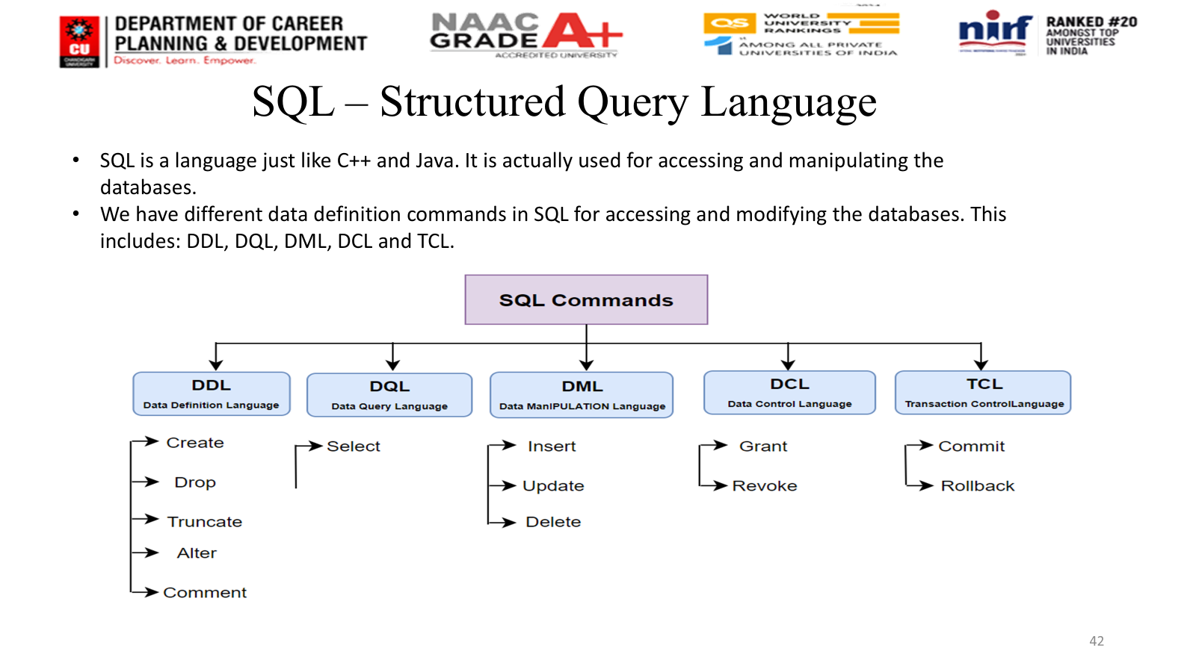
Winter Winning Camp
DATABASE MANAGEMENT SYSTEM
Department Of Career Planning & Development

Slide 3
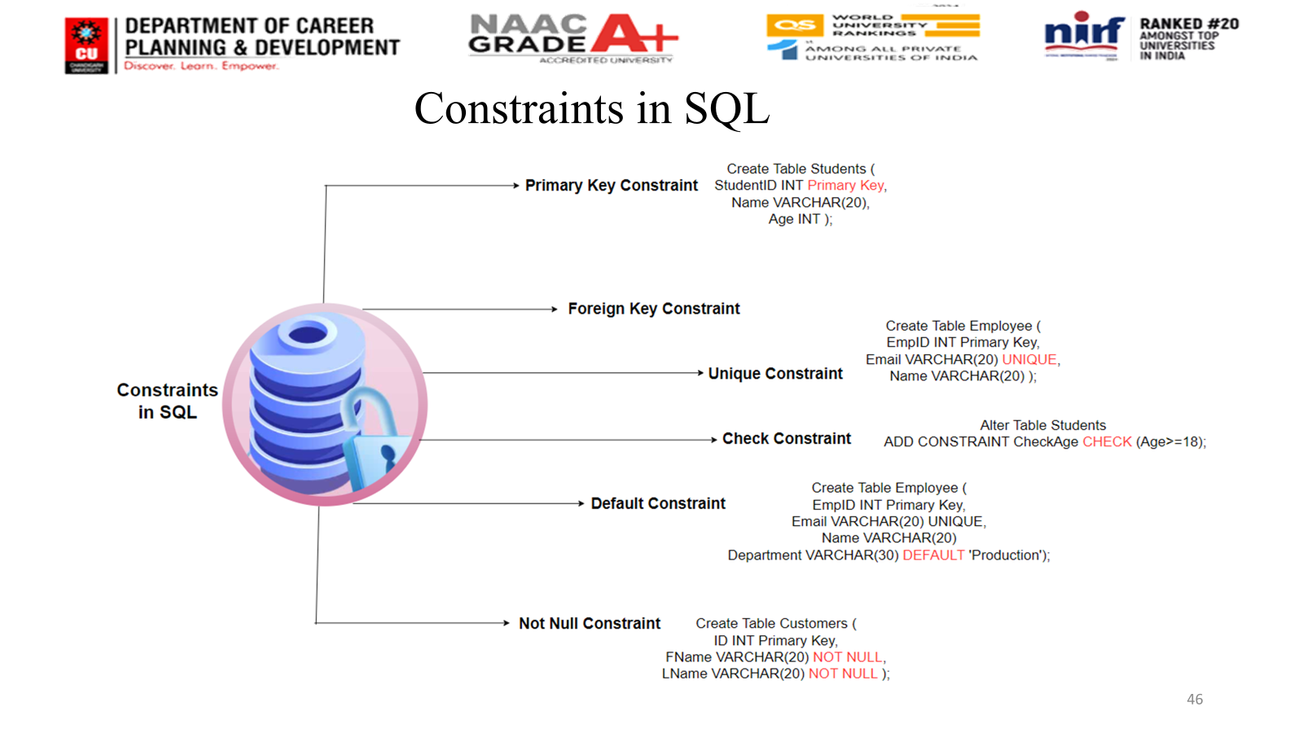
Winter Winning Camp
DATABASE MANAGEMENT SYSTEM
Department Of Career Planning & Development

Slide 4
Winter Winning Camp
DATABASE MANAGEMENT SYSTEM
Department Of Career Planning & Development

Slide 5
Views
1. VIEW IS A DATABASE OBJECT
2. VIEW IS CREATED OVER AN SQL QUERY
3. VIEW DOES NOT STORE ANY DATA
4. VIEW IS LIKE A VIRTUAL TABLE
5. DATA ABSTRACTION->Data abstraction in views means
hiding the complexity of database tables and presenting only the required information to the user, using a view.
6. SECURITY : ROW LEVEL & COLUMN LEVEL SECURITY

Slide 6
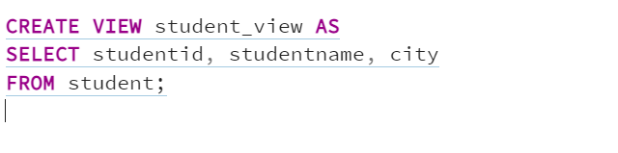
Row level security: restricts rows (with WHERE clause).
Column level security: restricts columns (by selecting only some columns).
So, a view is a security layer where you decide:
Which rows a user can access (row-level).
Which columns a user can access (column-level).
Syntax of Views Postgre:

Slide 7
MATERIALIZED VIEW:
Takes disk space
A materialized view (MV) is different: it stores the actual result of the query physically
Since results are precomputed and stored, queries on a materialized view run much faster.(Performance Boost)
Materialized views store physical data and cannot be updated and Inserted Data directly.

Slide 8
Refresh needed – Data in a materialized view can become stale(Out dated or not Fresh) if base tables change. That’s why we use:
REFRESH COMPLETE (rebuilds the whole MV)
Normal View | Materialized View
Stores only query | Stores actual data
Always up-to-date | Can become stale
No storage needed | Needs storage space
Slower (query runs each time) | Faster (precomputed results)

Slide 9
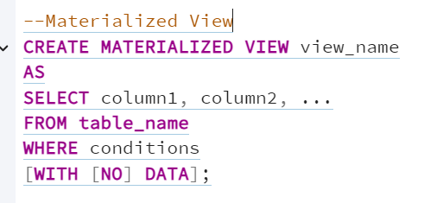
Syntax:
With data: It is optional tells PostgreSQL to populate(Add data in MV or Fill the Data) the materialized view immediately with the results of the query.
With No Data: Creates the MV structure but doesn’t fill it yet; you would need to run REFRESH MATERIALIZED VIEW sales_summary
Syntax: REFRESH MATERIALIZED VIEW sales_summary;

Slide 10
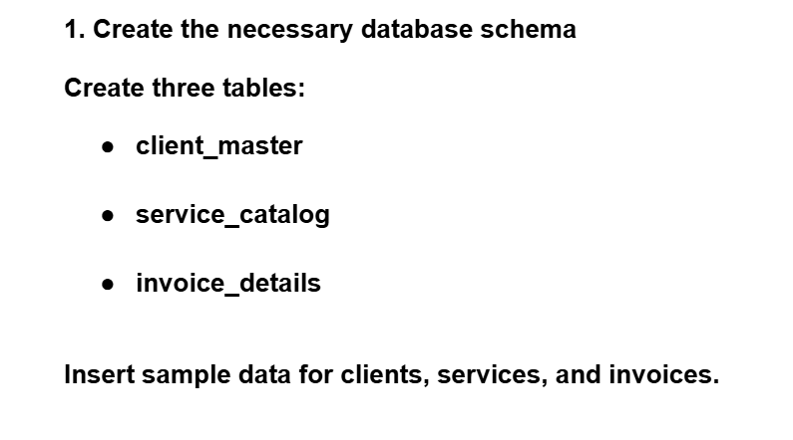
Question:

Slide 11
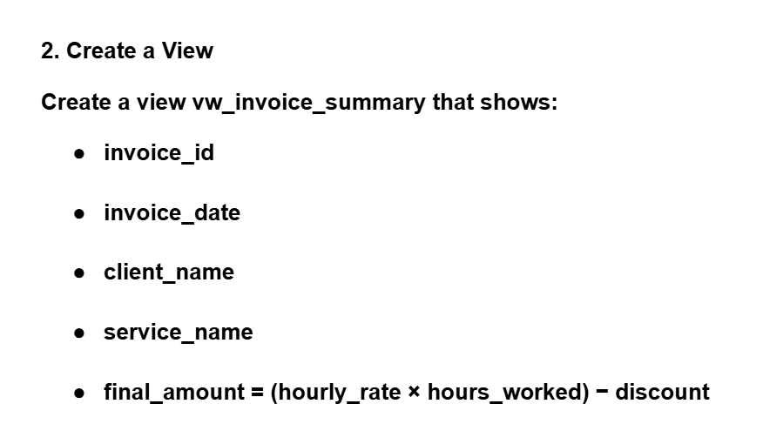
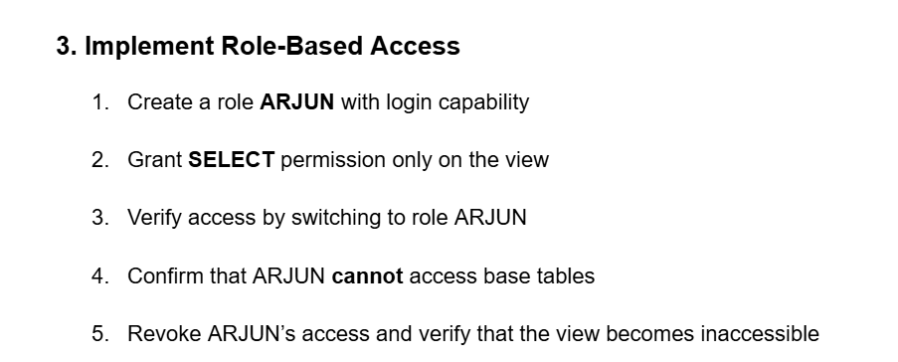

Slide 12
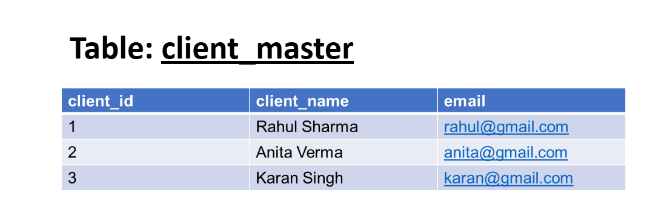
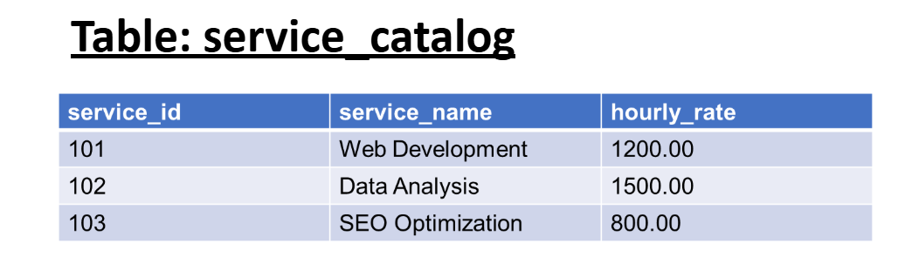

Slide 13
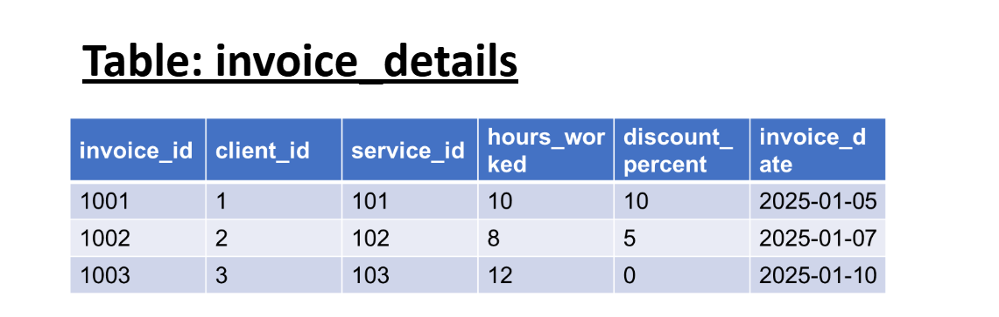

Slide 14
Referential Integrity
If Table A depends on Table B, then A cannot contain invalid or non-existing references.
CASCADE in SQL:
CASCADE is an action used with FOREIGN KEY constraints to control what happens to child-table rows when a referenced row in the parent table is UPDATED or DELETED.

Slide 15
Action | Meaning
ON DELETE CASCADE | Delete child rows automatically
ON UPDATE CASCADE | Update child rows automatically
ON DELETE SET NULL | Make child FK NULL
SET DEFAULT | Set child FK to default
NO ACTION / RESTRICT | Prevent delete/update if child exists

Slide 16
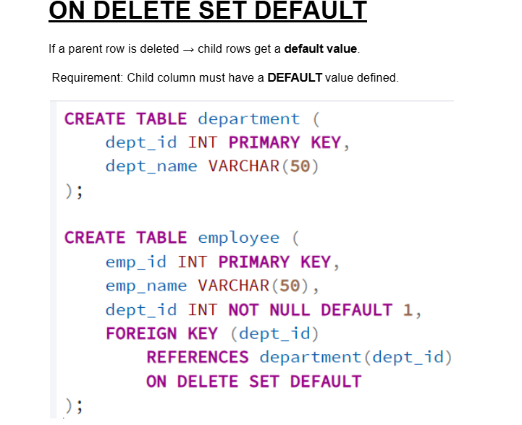

Slide 17
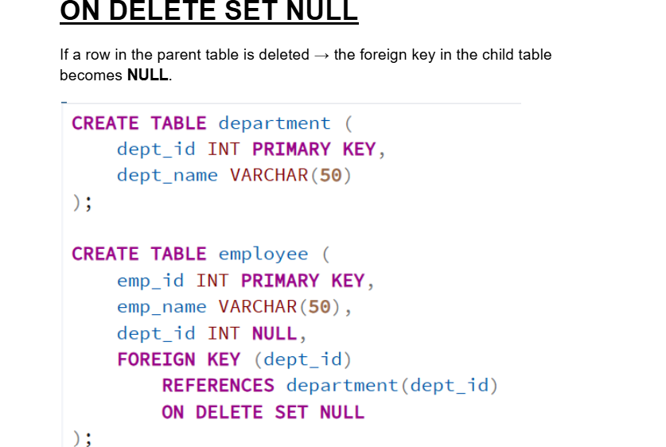


Slide 18
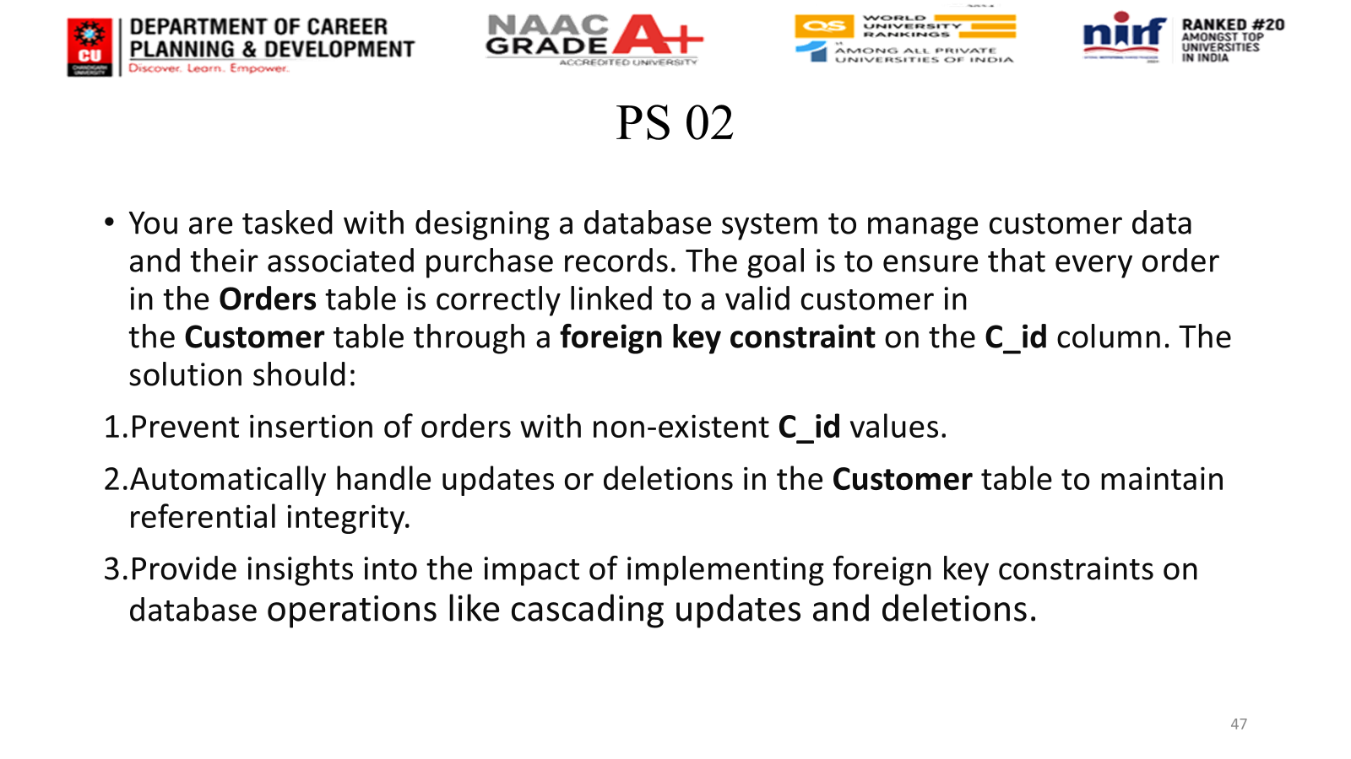
Winter Winning Camp
DATABASE MANAGEMENT SYSTEM
Department Of Career Planning & Development

